Slide 1
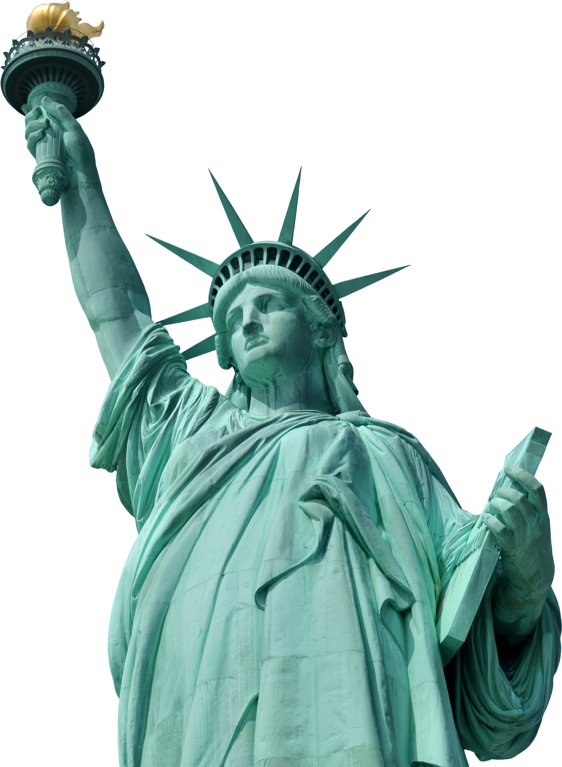

Introducing,
Libertas

Slide 2

Libertas
Making your Word,
Unstoppable.

Slide 3

What is
Libertas ?

Slide 4
What is
Libertas ?
A Decentralized & Censorship Resistant
Social Network

Slide 5
Libertas
Create & Share,
Videos and Articles.
A Decentralized & Censorship Resistant
Social Network
Interact with your audience via,
Live Streaming.
Talk to anyone,
anywhere via p2p calling.

Slide 6
Libertas
Decentralized
Governance

Slide 7
Libertas
Decentralized
Governance
By the community. For the community.

Slide 8
Libertas
Censorship Resistance

Slide 9





Libertas
Censorship Resistant
Pinata
& Decentralized

Slide 10



Libertas
Censorship Resistant
anuditnagar.crypto
libertyk4ithhrl2.onion
Unstoppable & Privacy Focused

Slide 11

Libertas
libertas.anudit.dev
Demo

